Slide 1
CIBERSORTx analysis
Hernan Lorenzi and Yunhua Zhu

Slide 2
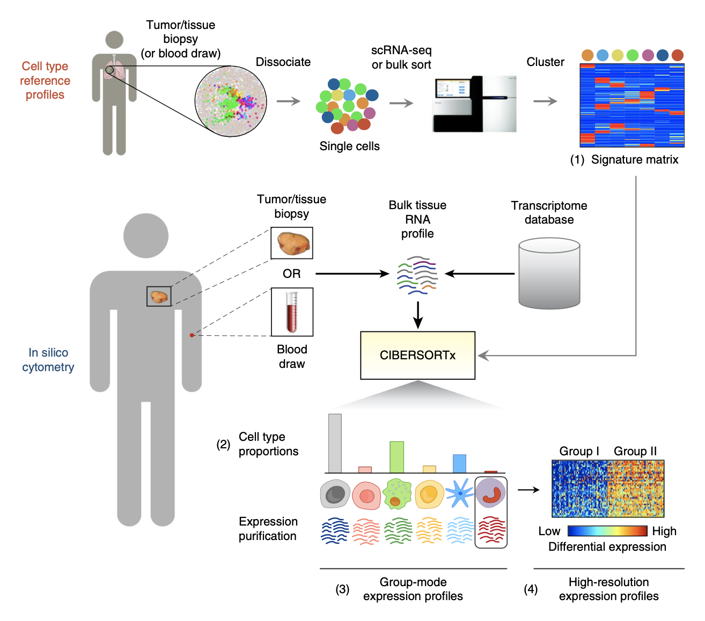
CIBERSORTx workflow

Slide 3
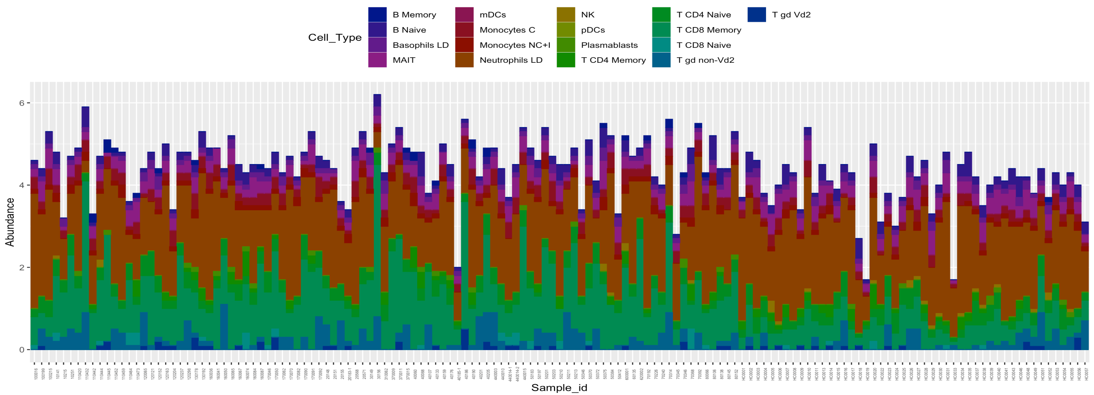
Predicted cellular composition profiles of samples based on CIBERSORTx
Signature matrix with expression profiles from 17 different PBMC cell types

Slide 4
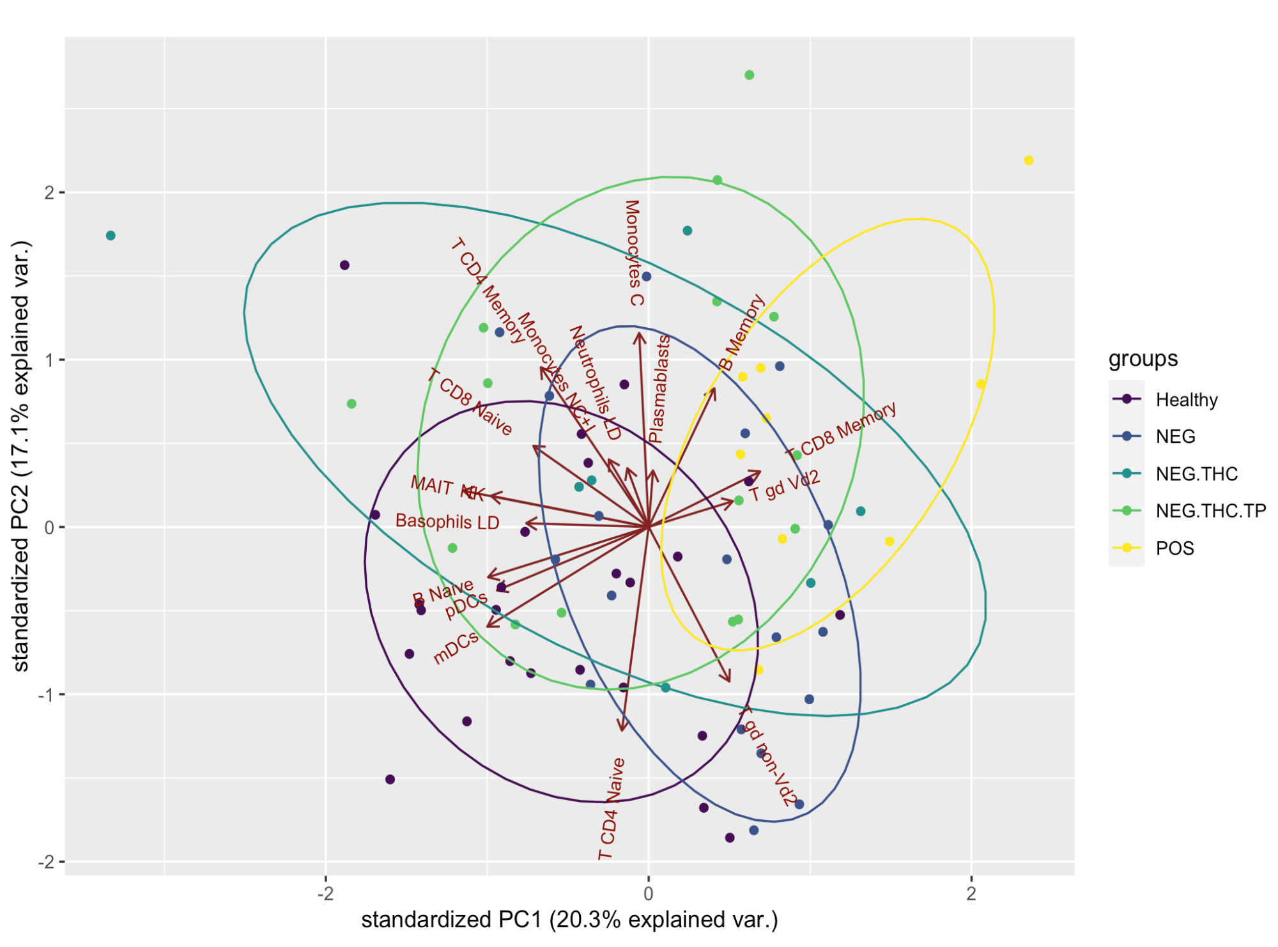
PCA plots of 5 groups of interest based on cellular composition profiles.
Study Groups:
Healthy: Healthy young individuals
Pos: YWH with detectable plasma HIV who did not use substances
Neg: YWH with undetectable plasma HIV who did not use substance
Neg. THC: YWH with undetectable plasma HIV who used only marijuana
NEG.THC.TP: YWH with undetectable plasma HIV who used marijuana in combination with tobacco

Slide 5
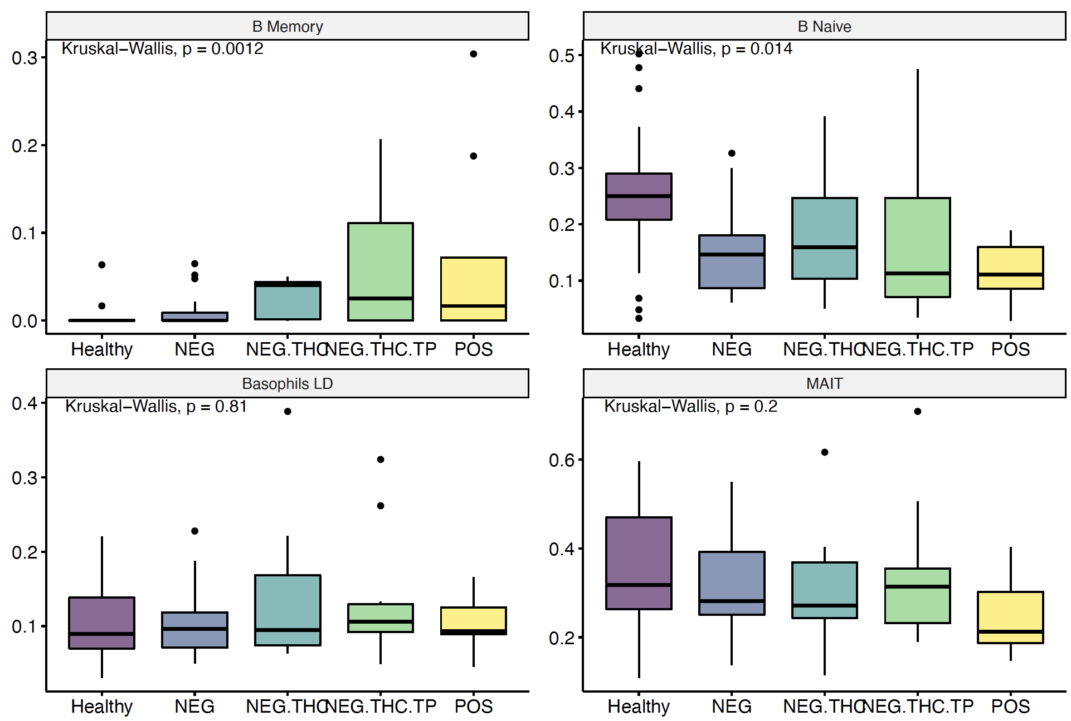
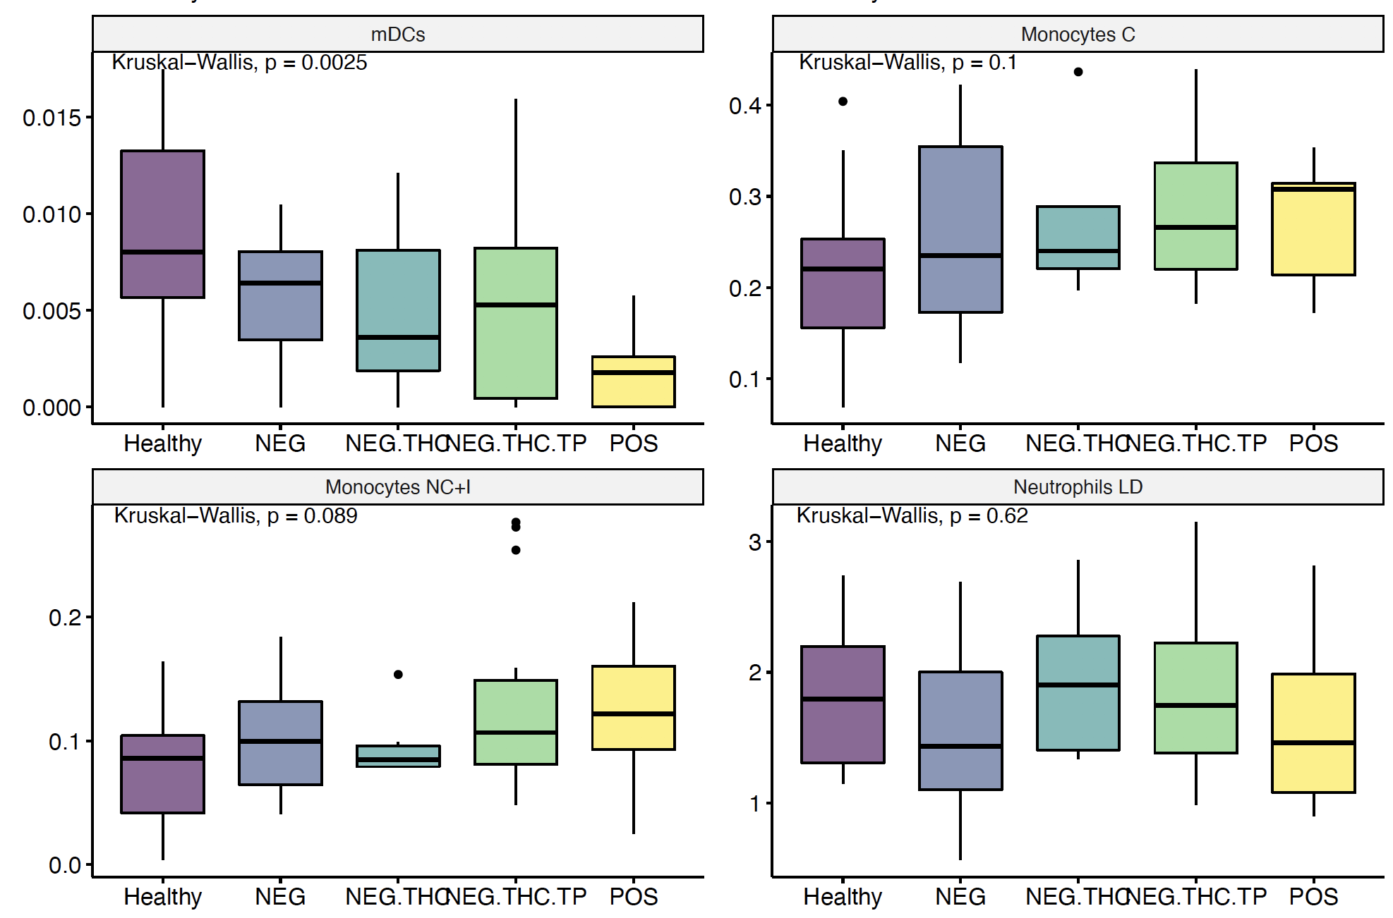
Cell type composition
**
*
**

Slide 6
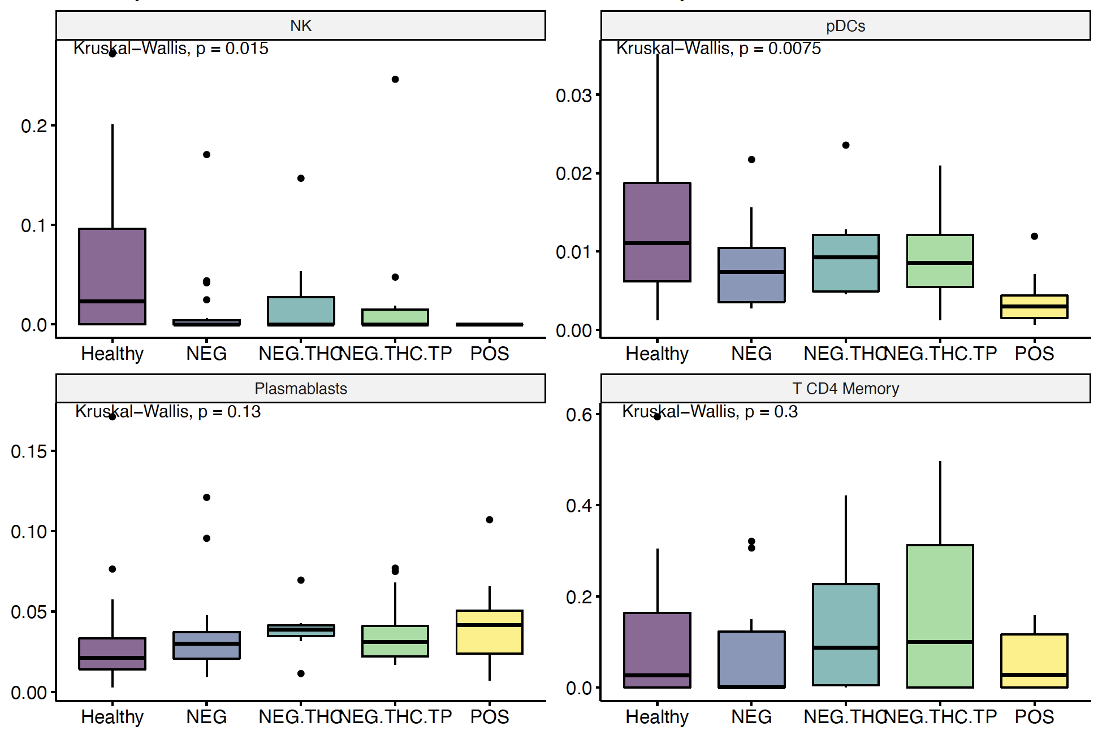
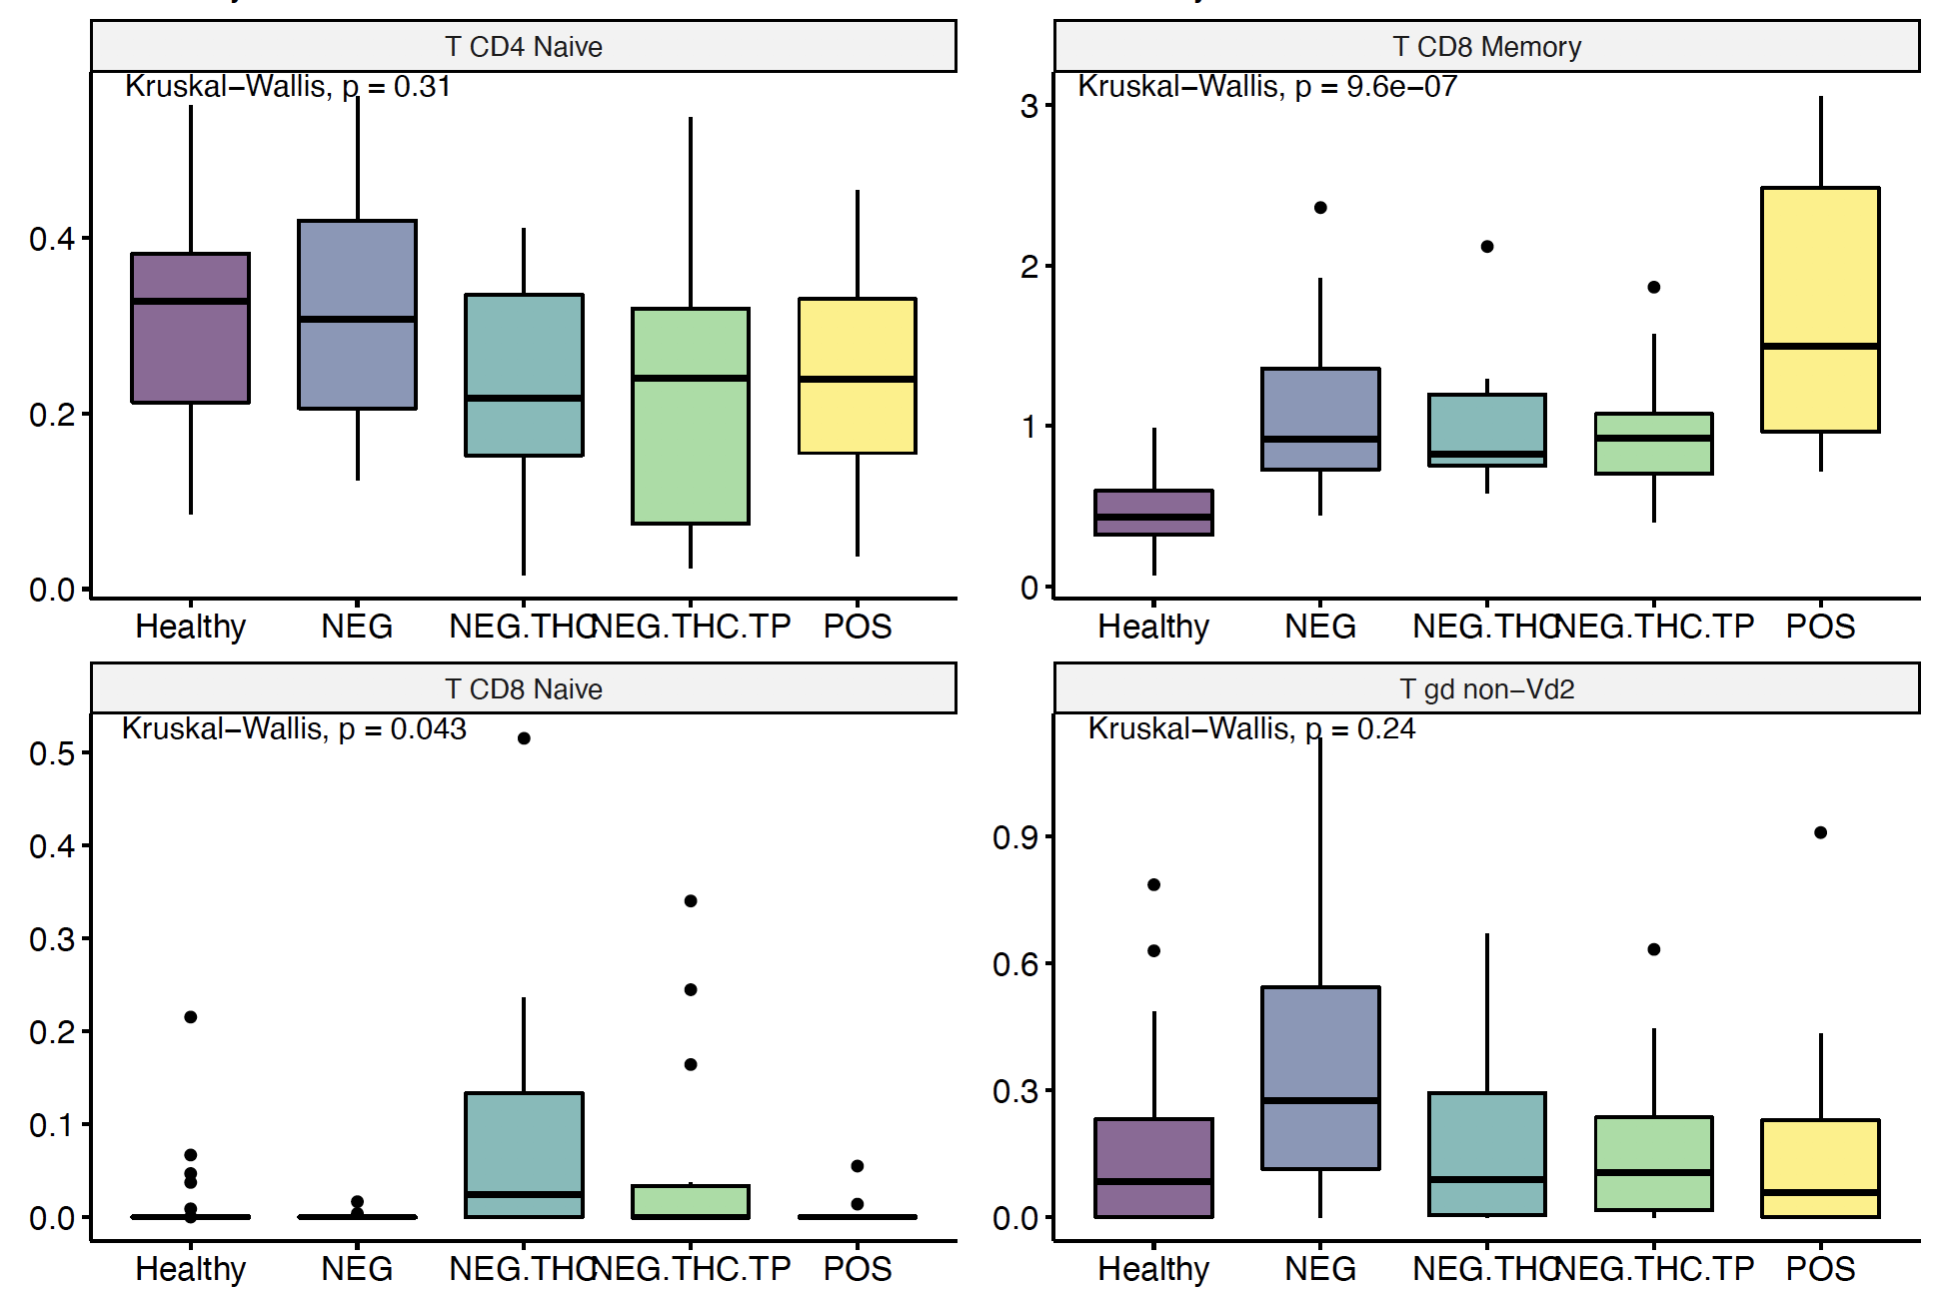
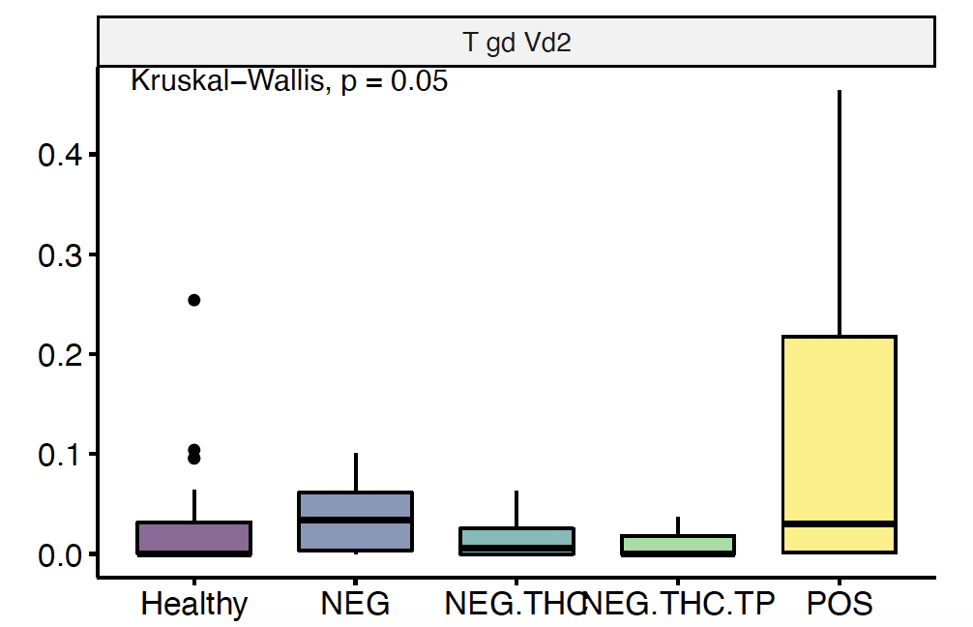
Cell type composition (cont.)
*
**
***
*
*

Slide 7
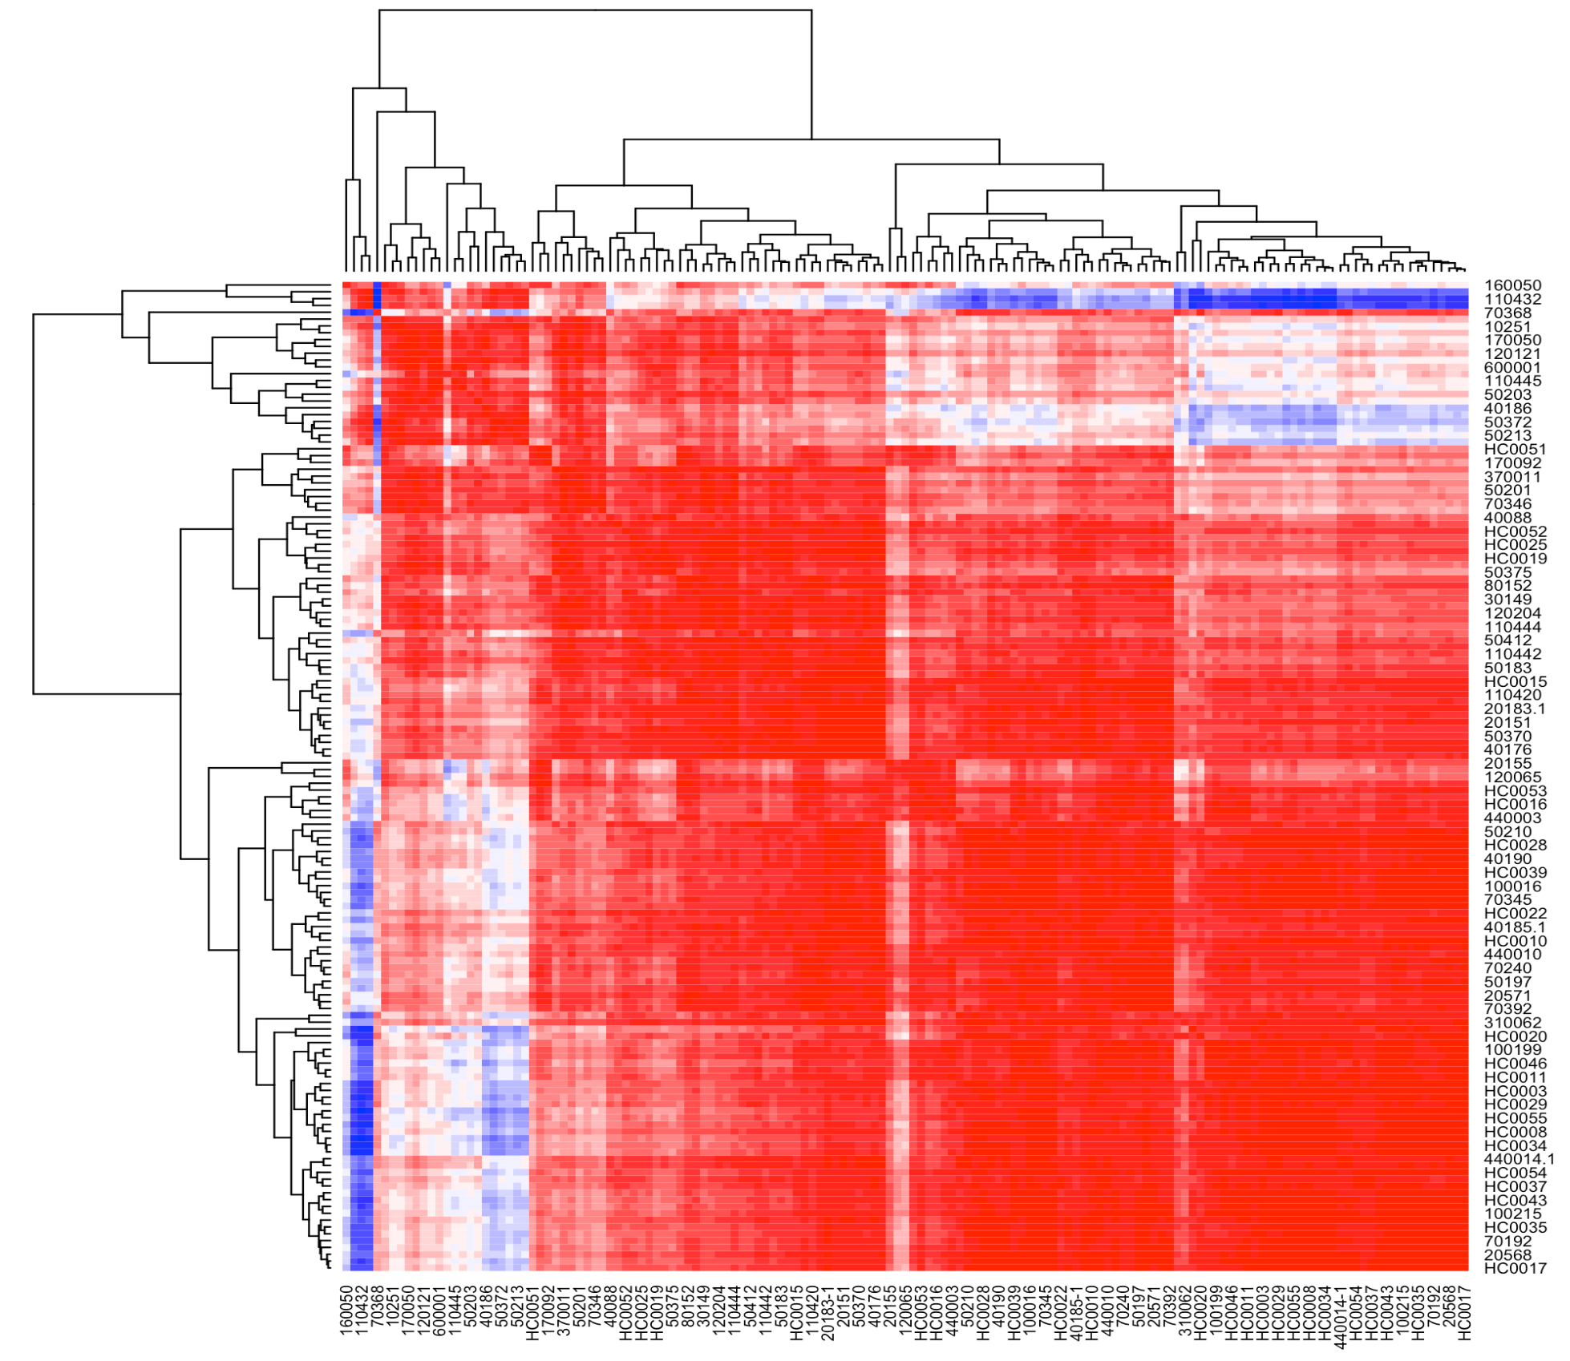
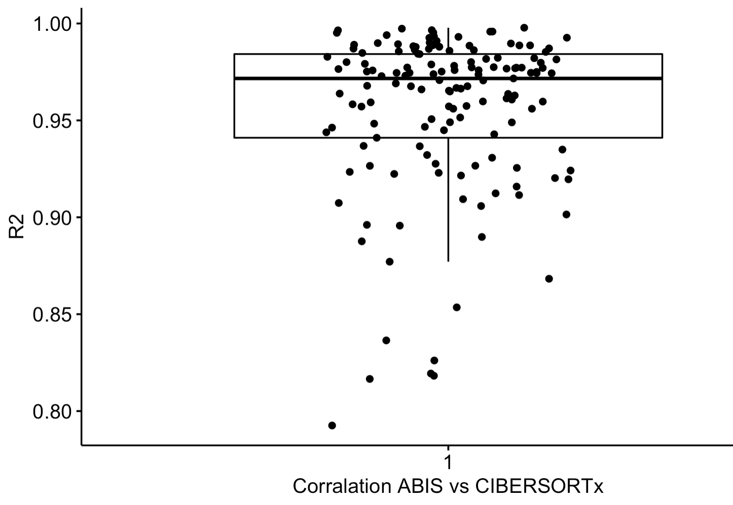
Correlation analysis between ABIS and CIBERSORTx predicted cell-type composition
Correlation R² values for all samples
ABIS
CIBERSORTx

Slide 8
Generation of mock bulk RNAseq samples from scRNAseq data: Cellular composition of mock samples
Mock samples with two experimental conditions, A and B
Unrelated mock samples
SC dataset has been downloaded from here:
https://cf.10xgenomics.com/samples/cell/pbmc3k/pbmc3k_filtered_gene_bc_matrices.tar.gz

Slide 9
Cellular deconvolution of mock bulk RNAseq samples

Slide 10
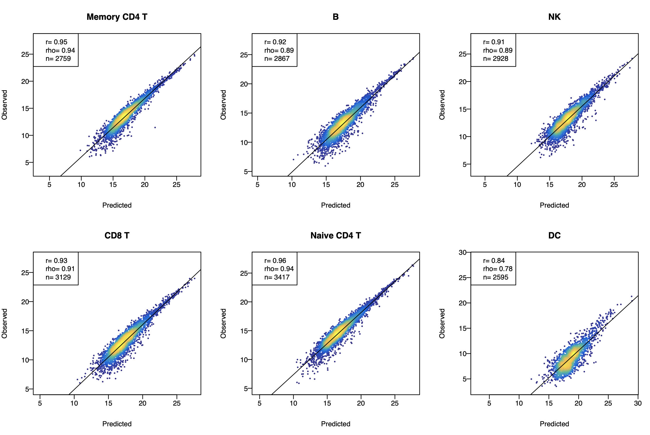
Impute Gene Expression, Group Mode
Signature Matrix Genes Only

